Slide 1


STATISTICS
Session 6: Hypothesis Testing

Slide 2
Observing Chance
We often hear people report astonishing findings:
A remarking coincidence
An unusually strong or weak effect
A result that seems far too unlikely
An unusual sequence of events
When we hear something astonishing, our first instinct may be to ask
“How could this possibly happen?”
But in statistics, there is another question we need to ask first:
“Is this result truly astonishing, or could we have seen something this extreme simply by random chance?”

Slide 3

Observing Chance
Suppose I tell you that “I’m psychic and can see the future.”
To prove my claim (that I am psychic), I flip a coin then cover it.
Would you be impressed is I correct called the outcome of the coin flip?
  Probably not, because my ‘prediction’ had a 50% chance of being correct by guessing alone

Slide 4

Observing Chance
$$\frac{1}{2}$$
Minh is psychic
The results were due to random chance
VS
Based on 1 flip
50%
$$\frac{1}{2}$$

Slide 5
Observing Chance
Minh is psychic
The results were due to random chance
VS
Based on 2 flips
25%

Slide 6
Observing Chance
Minh is psychic
The results were due to random chance
VS
Based on 3 flips
12.5%

Slide 7
Observing Chance
“Is this result truly astonishing, or could we have seen something
this extreme simply by random chance?”

Slide 8

The Lady Tasting Tea
?
?
?
?
?
?
?
?
 | Cup 1 | Cup 2 | Cup 3 | Cup 4 | Cup 5 | Cup 6 | Cup 7 | Cup 8
Decision: | M or T | M or T | M or T | M or T | M or T | M or T | M or T | M or T

Slide 9
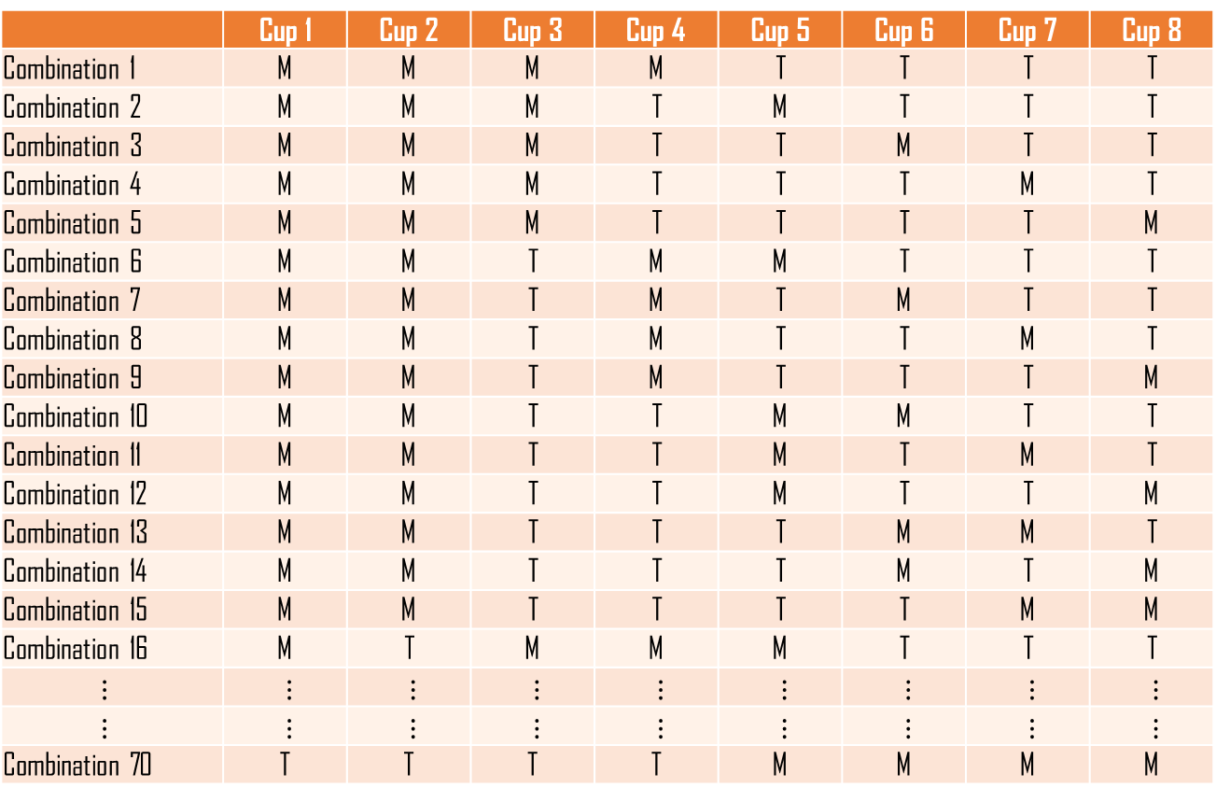
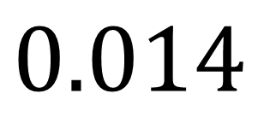
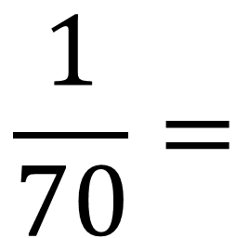
The Lady Tasting Tea
 | Cup 1 | Cup 2 | Cup 3 | Cup 4 | Cup 5 | Cup 6 | Cup 7 | Cup 8
Combination 1 | M | M | M | M | T | T | T | T
Combination 2 | M | M | M | T | M | T | T | T
Combination 3 | M | M | M | T | T | M | T | T
Combination 4 | M | M | M | T | T | T | M | T
Combination 5 | M | M | M | T | T | T | T | M
Combination 6 | M | M | T | M | M | T | T | T
Combination 7 | M | M | T | M | T | M | T | T
Combination 8 | M | M | T | M | T | T | M | T
Combination 9 | M | M | T | M | T | T | T | M
Combination 10 | M | M | T | T | M | M | T | T
Combination 11 | M | M | T | T | M | T | M | T
Combination 12 | M | M | T | T | M | T | T | M
Combination 13 | M | M | T | T | T | M | M | T
Combination 14 | M | M | T | T | T | M | T | M
Combination 15 | M | M | T | T | T | T | M | M
Combination 16 | M | T | M | M | M | T | T | T
$$⋮$$ | $$⋮$$ | $$⋮$$ | $$⋮$$ | $$⋮$$ | $$⋮$$ | $$⋮$$ | $$⋮$$ | $$⋮$$
$$⋮$$ | $$⋮$$ | $$⋮$$ | $$⋮$$ | $$⋮$$ | $$⋮$$ | $$⋮$$ | $$⋮$$ | $$⋮$$
Combination 70 | T | T | T | T | M | M | M | M
$$\frac{1}{70}=$$
$$0.014$$

Slide 10



Hypothesis Testing
Population
parameter
$$μ,σ,etc.$$
Hypothesis Testing
Enough evidence to
infer the results
back to the
population
Not enough evidence to infer the results
back to the
population
statistic
$$\overline{x},s,etc.$$
Sample

Slide 11
Hypothesis Testing
Everyday questions
Hypothesis-Testing questions
“Do Australians earn a good income?”
“Is the mean annual income of Australian adults different from $100,000?”
“Do students who study at least 10 hours per week have a higher mean exam score than students who study less than 10 hours?”
“Does studying more improve exam results?”
“Does studying more improve exam results?”
“Is there a positive relationship between the number of hours studied and exam score?

Slide 12
Null Hypothesis Significance Testing (NHST)
A classical framework used to decide whether observed data provide enough evidence to reject a default assumption (usually of no effect or no difference)
Null Hypothesis (H₀)
Alternative Hypothesis (H₁)
The default or baseline position in a hypothesis test. It typically states that there is no effect, no difference, or no relationship in the population. It provides a benchmark against which we evaluate the evidence in our sample data.
The claim or effect that we are looking for evidence in favour of. It typically states that there is an effect, difference, or relationship in the population, or that a population parameter differs from a specified value.

Slide 13






Null and Alternative Hypotheses
Everyday
questions
Null and Alternative hypotheses
Hypothesis-Testing questions
“Do Australians earn a good income?”
“Is the mean annual income of Australian adults different from $100,000?”
$$H_{0}:μ=100,000$$
$$H_{1}:μ≠100,000$$
“Does studying more improve exam results?”
“Do students who study at least 10 hours per week have a higher mean exam score than students who study less than 10 hours?”
$$H_{0}:μ_{≥10}=μ_{<10}$$
$$H_{1}:μ_{≥10}>μ_{<10}$$
“Does studying more improve exam results?”
“Is there a positive relationship between the number of hours studied and exam score?
$$H_{0}:β=0$$
$$H_{1}:β>0$$

Slide 14
Null and Alternative Hypotheses
The Role of the Null Hypothesis
It is the position we assume for the purpose of the test. We then ask whether the data look unusual under that assumption, and if so, we can reject the null.

Slide 15






Null and Alternative Hypotheses
Hypothesis-Testing questions
Null hypothesis
Alternative hypothesis
“Is the mean annual income of Australian adults different from $100,000?”
$$H_{0}:μ=100,000$$
$$H_{1}:μ≠100,000$$
“Do students who study at least 10 hours per week have a higher mean exam score than students who study less than 10 hours?”
$$H_{0}:μ_{≥10}=μ_{<10}$$
$$H_{1}:μ_{≥10}>μ_{<10}$$
“Is there a positive relationship between the number of hours studied and exam score?
$$H_{0}:β=0$$
$$H_{1}:β>0$$

Slide 16
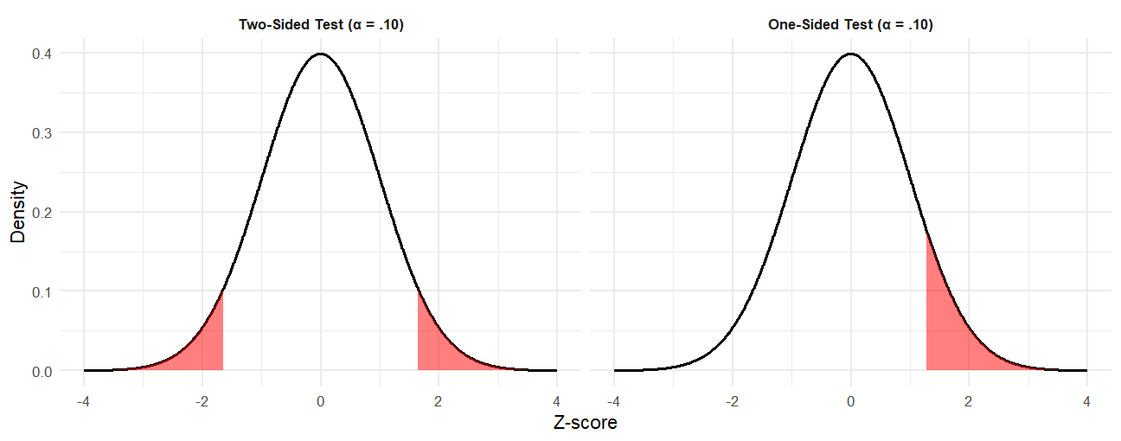
Directional Hypotheses
.10
.05
.05

Slide 17

Test Statistic
$$μ=100,000$$
Hypothesis Testing
Enough evidence
Not enough evidence
State hypotheses & sig. level
Compute test statistic
Compare to critical value
Make conclusion
Sample

Slide 18
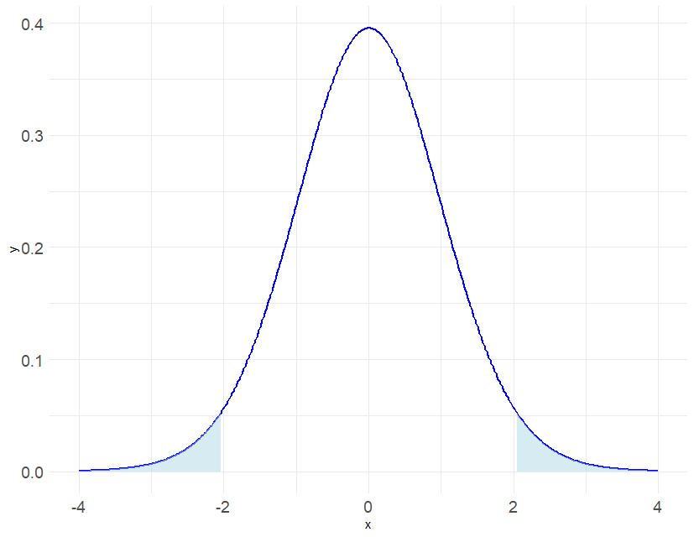








Critical value method
p-value method
Confidence Interval method
When the test statistic (t) is more extreme than the critical region
When the p-value for the computed test statistic is less than the significance level*
When the confidence interval does not capture $μ$
t = 3.01
$$μ$$
Statistically significant
$$p<α$$
Reject H₀
-5
-4
-3
-2
-1
0
1
2
3
4
5
6
* Unless otherwise stated, use $α=0.05$
When the test statistic (t) is not more extreme than the critical region
When the p-value for the computed test statistic is greater than the significance level*
When the confidence interval does capture $μ$
t = 1.84
$$μ$$
Not Statistically significant
$$p>α$$
Fail to reject H₀
-5
-4
-3
-2
-1
0
1
2
3
4
5
6
* Unless otherwise stated, use $α=0.05$

Slide 19
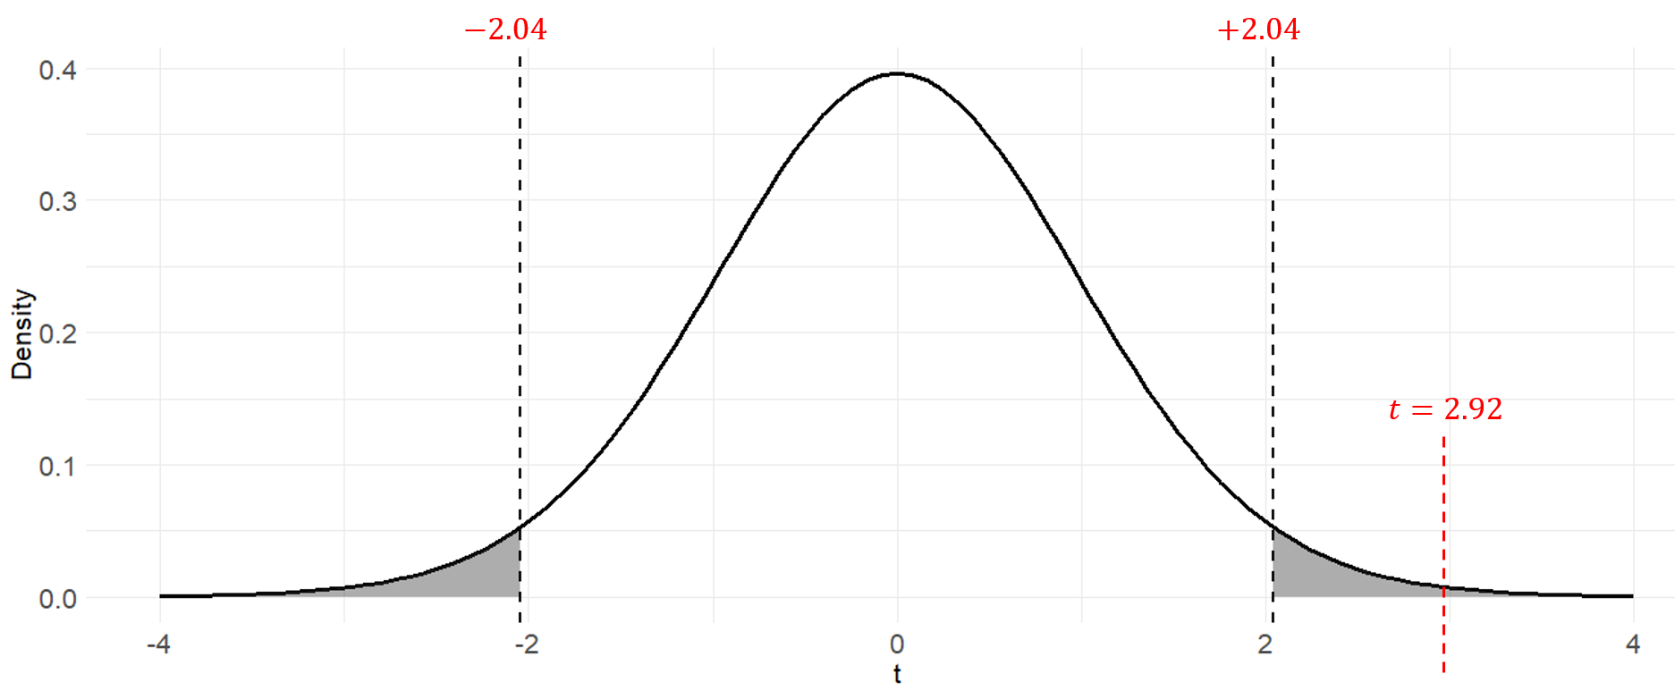







Critical Value Method
Suppose a recent report suggested that the mean annual income of Australians is $100,000. You want to test this claim so you sample a small number of households (n = 30) and find that the mean and std. deviation of your sample are $108,000 and $15,000, respectively.
Using the NHST framework, determine if your estimate is significantly different to the claimed value, or if the results of your sample are due to chance.
Step 1. State hypotheses and significance level
$$H_{0}:μ=100,000$$
$$H_{1}:μ≠100,000$$
$$α=0.05$$
Step 2. Compute the test-statistic
$$t=\frac{\overline{x}−μ}{s/{\sqrt{n}}}$$
$$=\frac{108000−100000}{{15000}/{\sqrt{30}}}$$
$$≈2.92$$
Step 3. Compare test-statistic to critical value
$$t=2.92>t^{∗}=2.04$$
Step 4. Make a conclusion
Reject H₀
There is statistically significant evidence that the mean annual income of Australian households differs from $100,000.

Slide 20

P-value Method
Suppose a recent report suggested that the mean annual income of Australians is $100,000. You want to test this claim so you sample a small number of households (n = 30) and find that the mean and std. deviation of your sample are $108,000 and $15,000, respectively.
Using the NHST framework, determine if your estimate is significantly different to the claimed value, or if the results of your sample are due to chance.
Step 1. State hypotheses and significance level
$$H_{0}:μ=100,000$$
$$H_{1}:μ≠100,000$$
$$α=0.05$$
Step 2. Compute the test-statistic
$$t=\frac{\overline{x}−μ}{s/{\sqrt{n}}}$$
$$=\frac{108000−100000}{{15000}/{\sqrt{30}}}$$
$$≈2.92$$
Step 3. Compute the p-value associated with the test statistic and compare to the significance level
$$p=0.0067<α=0.0500$$
Step 4. Make a conclusion
Reject H₀
There is statistically significant evidence that the mean annual income of Australian households differs from $100,000.

Slide 21

Confidence Interval Method
Suppose a recent report suggested that the mean annual income of Australians is $100,000. You want to test this claim so you sample a small number of households (n = 30) and find that the mean and std. deviation of your sample are $108,000 and $15,000, respectively.
Step 1. State hypotheses and significance level
$$H_{0}:μ=100,000$$
$$H_{1}:μ≠100,000$$
$$α=0.05$$
Step 2. Compute the test-statistic
$$t=\frac{\overline{x}−μ}{s/{\sqrt{n}}}$$
$$=\frac{108000−100000}{{15000}/{\sqrt{30}}}$$
$$≈2.92$$
Step 3. Compute the CI and see if it capture the population parameter of interest
95%CI$=102413.2 to 113586.8$
Step 4. Make a conclusion
96
100
104
108
112
116
Reject H₀
There is statistically significant evidence that the mean annual income of Australian households differs from $100,000.

Slide 22
How Many Outcomes?
Outcome Type?
How Many Exp. Vars?
Exp. Var. Type?
If Exp. == Cat, how many levels?
If Exp. == Cat, are levels different or same?
Continuous
Correlation / Regression
Reference
One sample t-test
One
Same
Paired sample t-test
Two
Different
Two sample t-test
Categorical
Same
Repeated measures ANOVA
Continuous
Two+
Different
One way ANOVA
Continuous
Multiple Regression
One
Two+
Categorical
Different
Factorial ANOVA / M Regression
Both
Factorial Mixed ANOVA
Both
ANCOVA / M Regression
Continuous
Logistic Regression
One
Categorical
Different
Chi Square
Categorical
Continuous
Logistic Regression
Two+
Categorical
Different
Loglinear Regression
Both
Different
Logistic Regression
One
Categorical
MANOVA
Two+
Continuous
Categorical
Factorial MANOVA
Two+
Both
MANCOVA

Slide 23

Two Sample t-test
Population 1
Population 2
Sample 1
Inference
Sample 2
160
155
165
170
160
170
165
175
185
165
175
180
185
170
185
190
185
175
200
180
Mean = 167
Mean = 182.5
Difference = 15.5
150
155
160
165
170
175
180
185
190
200
150
155
160
165
170
175
180
185
190
200

Slide 24
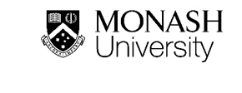

Paired t-test
Population
Make a decision
Enough evidence
Not enough evidence
Sample (time 1)
5.2
4.8
6.7
4.9
5.1
5.2
5.2
4.9
6.3
5.7
$$\overline{d}={\overline{x}}_{2}−{\overline{x}}_{1}$$
Sample (time 2)
5.0
4.7
6.1
5.3
5.2
4.9
4.8
4.9
5.1
5.7

Slide 25


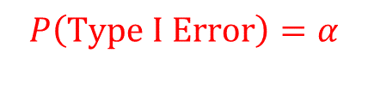
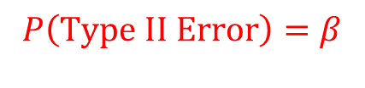


Type I and Type II Errors
$$Power=1−β$$
Truth
$$P\left(Type I Error\right)=α$$
Reject H₀
Fail to reject H₀
Reject H₀
Correct
Type I Error
Statistical Test
Fail to reject H₀
Type II Error
Correct
$$P\left(Type II Error\right)=β$$

